Slide 1
What is a computer?
Mack 2021

Slide 2
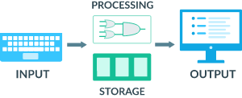
What is a computer?
If you're reading this right now, you're using a computer. Maybe it's a laptop, maybe a desktop computer, or perhaps even a smartphone. They may look different, but they all share the same underlying technology. The more we understand how that technology works, the more we can use the computers around us to help make our world better.
Every computer takes in input data, stores and processes it, and outputs results in some way.
Notes:
In this unit, we'll dive deeper into the workings of computers, starting with understanding how computers represent data as 1s and 0s, then finding out how they process 1s and 0s with logic circuits inside a CPU, and finally learning about file sizes and compression.

Slide 3


Slide 4
From electricity to bits

Slide 5

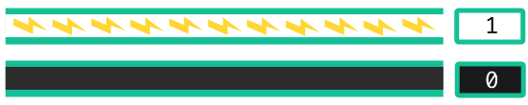
From electricity to bits
In a computer, information travels over wires. The easiest way to convey information in a wire is to consider it "on" or "off", based on how much electricity is going through it.
An "on" wire represents 1, and an "off" wire represents 0.
This small piece of information is called a "bit", and it's the smallest piece of information that computers process.

Slide 6
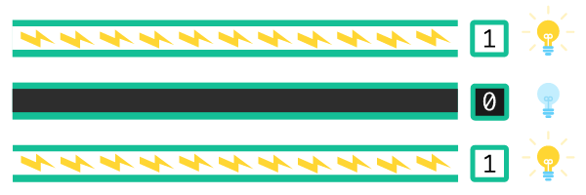
More wires = more bits
A single wire can only represent one bit, one piece of information. We can represent the results of a coin flip with a single bit—by saying that 0 represents tails and 1 represents heads—but we usually need to represent much more information than that in a computer.
The solution? More wires! Each wire adds an additional bit of information, an extra bit that can be considered on or off, 1 or 0.
For example, let's say we want to represent which of three lightbulbs to turn on. We can use three wires, with each wire representing the on/off state of a lightbulb:
Notes:
In computers, we use bits to represent numbers, using the binary number system. We'll dive deep into binary numbers in the next article.

Slide 7
Behind the abstraction
In actuality, a wire isn't exactly "on" or exactly "off". That's an abstraction that simplifies the details of how computers work. We use abstraction often in computer science so that we can more easily understand the systems that we're building. Let's peek behind the hood to see how this abstraction works.
A wire can have varying amounts of electricity flowing through it, but a computer needs to be able to interpret the electricity in a wire as either definitely 0 or definitely 1.
In 1947, engineers invented the transistor, a tiny physical device that acts like a digital switch in computers. The transistor turns on when enough electricity flows through and stays off otherwise.

Slide 8
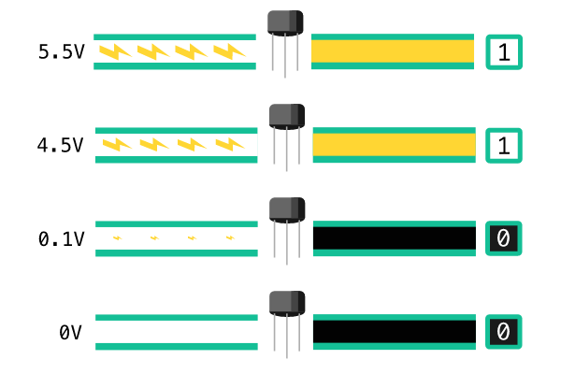
Behind the abstraction
How much electricity is "enough"? That depends on the transistor and its threshold voltage. If an engineer uses a transistor with a threshold voltage of 4.5 volts, then any voltage of 4.5 or higher will turn the transistor on. At lower voltages, the transistor stays off.
Consider a computer that needs to determine whether a USB cable is plugged in. When you plug the cable of a mouse in the computer's USB port, circuitry in the mouse uses the voltage provided by the port to pull up the voltage in the cable above 3.3 volts. Inside the computer, a transistor detects the high voltage and translates it to "on" or 111. This bit of information tells your computer that a USB device is plugged into the port.

Slide 9
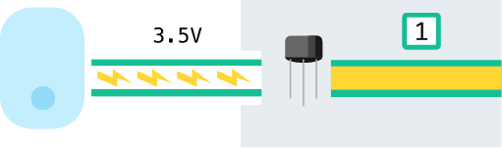
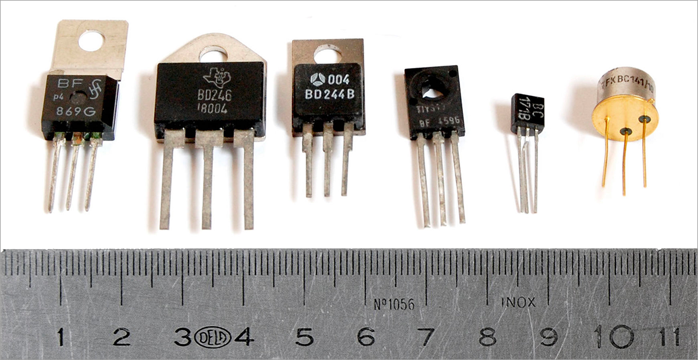
Behind the abstraction
In this case, engineers used a transistor with the threshold voltage of 3.3 volts for the "on" state, and of 0.3 volts for the "off" state.
There's a huge variety in transistors. Engineers choose the transistors that are the best fit for the job, by considering characteristics like the threshold voltage, material, and size.
The transistors inside your computer are so small, we would need a high-powered microscope to see them. However, transistors are also used in other electrical projects and those transistors are ones you could pick up with your fingers. Here are a few examples:

Slide 10
Behind the abstraction
A lot of electrical engineering and physics goes into the physical construction of computer hardware like transistors, and we won't dive deep into that here. If you'd like to learn more, check out this video on how a transistor works.
An important takeaway here is that computers are built on layers of abstraction, like bits abstracting on top of transistors. Those layers enable computer scientists to use and control computers in predictable ways.

Slide 11

Pretend your friend was absent from class today… Write what you would say if you had to explain the lesson to your friend.
Notes:
Summarize
Use the template to prompt students to think about the most important aspects of the lesson. By asking them to consider their friend, you help them develop the skills to consider another person’s needs and learn to summarize information.
🍐 This is a Pear Deck Text Slide
🍐 To edit the type of question, go back to the "Ask Students a Question" in the Pear Deck sidebar.

Slide 12
Practice Time

Slide 13
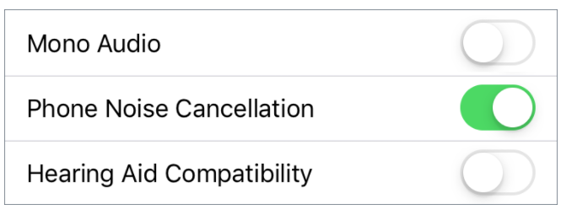
From electricity to bits
The Apple iPhone includes a settings menu where you can toggle various accessibility options on or off:
What is the minimum number of bits that can represent those 3 options?
Notes:
🍐 This is a Pear Deck Text Slide
🍐 To edit the type of question, go back to the "Ask Students a Question" in the Pear Deck sidebar.

Slide 14
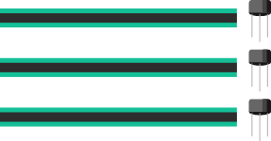
From electricity to bits
Adrian is making a simple computer using 3 wires.
Each wire can be considered either "on" or "off" depending on its voltage, thanks to the transistors.
How many bits of information can those wires represent?
Notes:
🍐 This is a Pear Deck Text Slide
🍐 To edit the type of question, go back to the "Ask Students a Question" in the Pear Deck sidebar.

Slide 15
From electricity to bits
What values can a binary digit represent?
Notes:
🍐 This is a Pear Deck Multiple Choice Slide. Your current options are: A: A binary digit can only represent the value 1., B: A binary digit can only represent the value 0., C: A binary digit can represent either the value 0 or 1., D: A binary digit can represent one of the values from 0 - 9.,
🍐 To edit the type of question or choices, go back to the "Ask Students a Question" in the Pear Deck sidebar.

Slide 16
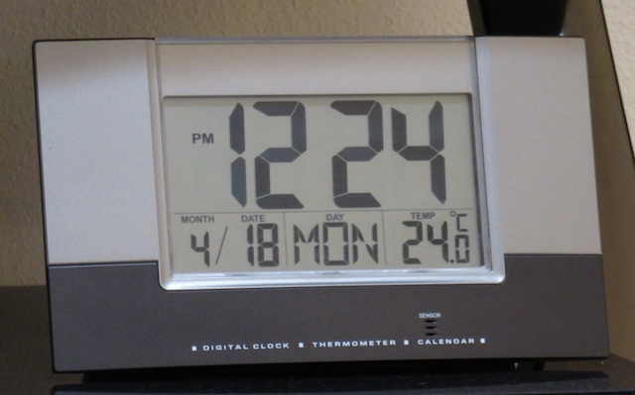
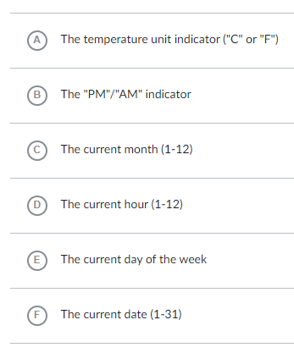
From electricity to bits
Digital alarm clocks display information and visual indicators to help people wake up on time:
Which of the displays could be represented by a single bit?
👁️Note that there are 2 answers to this question.
Choose 2 answers:
Notes:
🍐 This is a Pear Deck Text Slide
🍐 To edit the type of question, go back to the "Ask Students a Question" in the Pear Deck sidebar.

